Slide 1
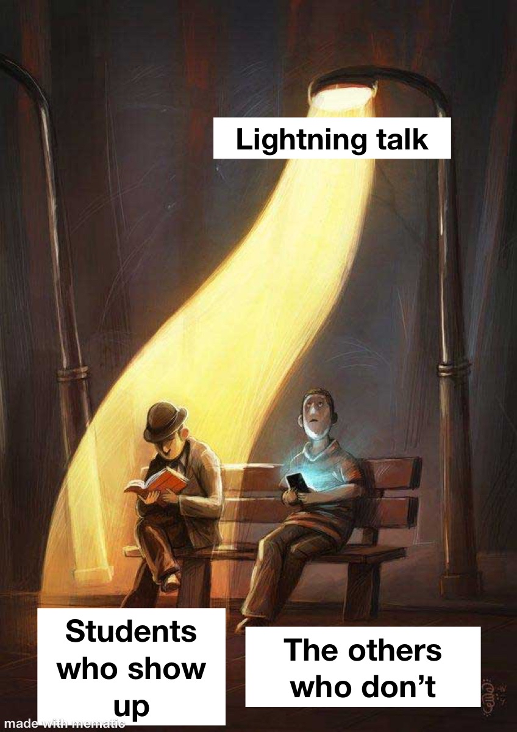
Welcome to the Leuphana Tutorium!
School vs. University
15.10.2025
Hannah Splitter, Ariane Steiner, Leon Stöcker and Katharina Lohner
Notes:
Hannah

Slide 2
Agenda
Structure of the Leuphana Semester Tutorium
Quick Activity Break
Comparing School and University

Slide 3
Structure of the Leuphana Tutorium
Team made up out of older students
Weekly lightning talks (Wednesday, 14.15, HS 1)
Regarding different topics relevant to studying and a
Help Desk in the trafos
Here to help you with all questions regarding starting university and studying

Slide 4


Structure of the Leuphana Tutorium
We are 16 experienced students that will help you throughout the Leuphana Semester
Lightning Talks
Help Desk
Wen., HS 1 14:15 – 14:45
Giving you relevant information about studying
Mo., Wen. & Fr.
Individual support for all questions regarding University
Notes:
ari

Slide 5
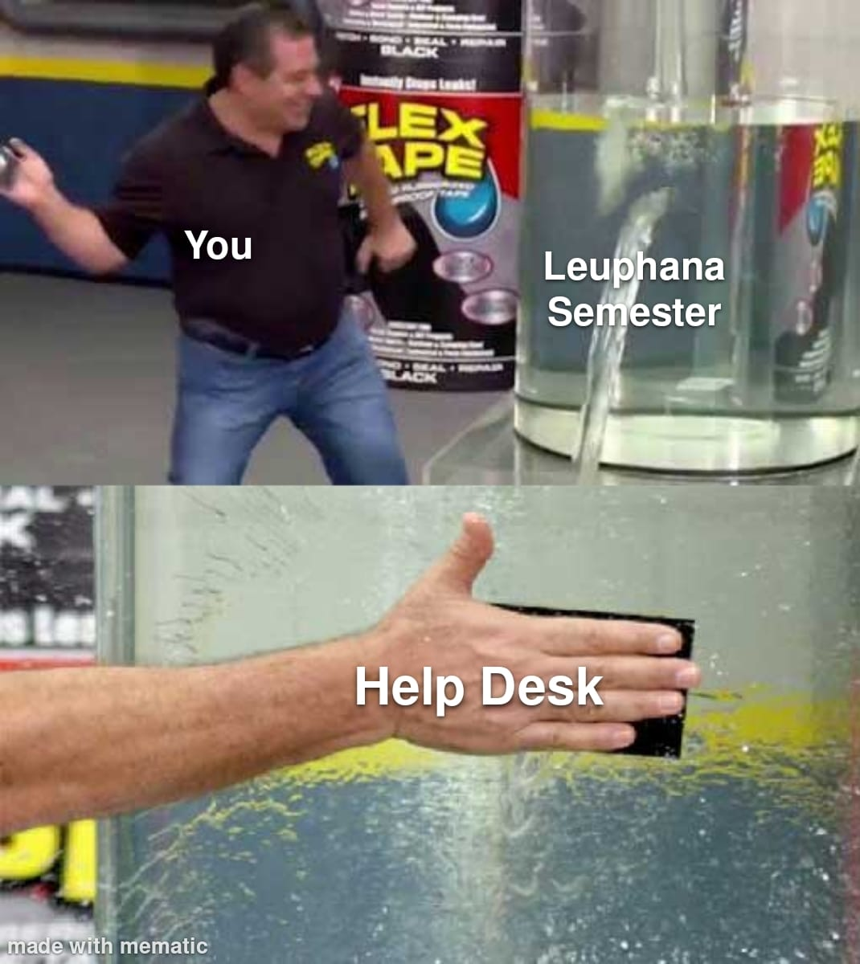
Structure of the Leuphana Tutorium
We are 16 experienced students that will help you throughout the Leuphan Semester
Lightning Talks
Help Desk
Wen., HS 1 14:15 – 14:45
Giving you relevant information about studying
Mo., Wen. & Fr.
Individual support for all questions regarding University

Slide 6
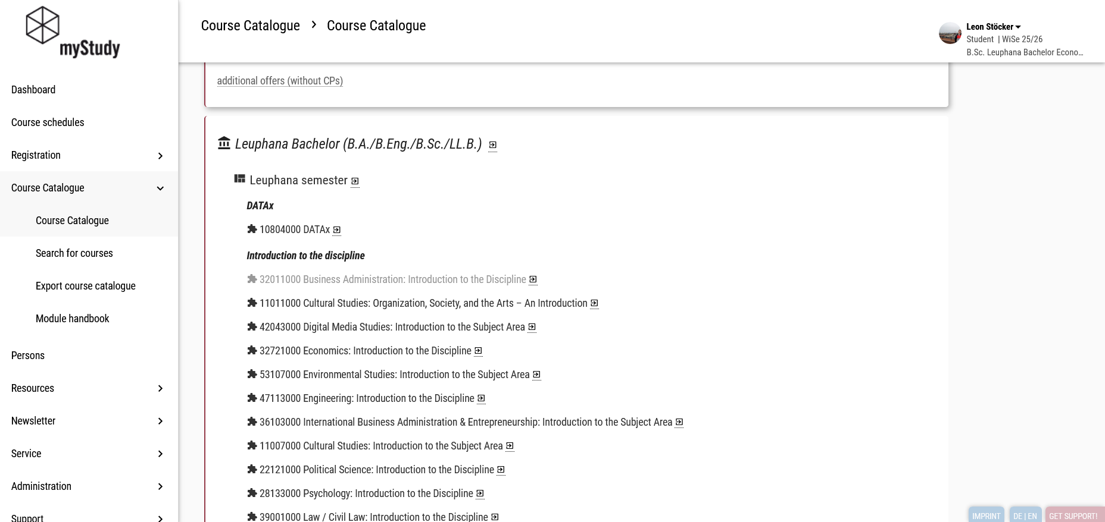
Notes:
leon

Slide 7
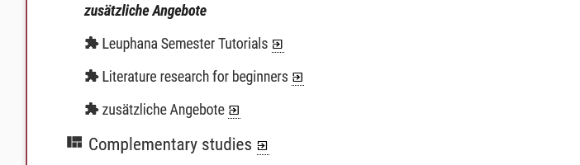
Notes:
leon

Slide 8
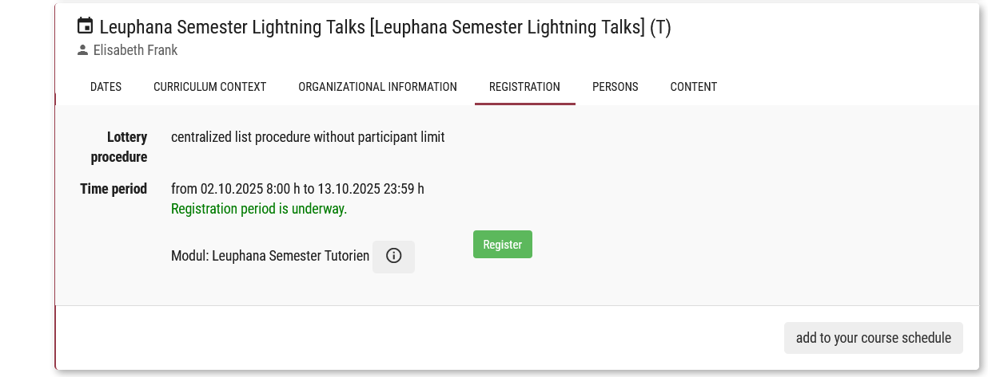
Notes:
leon

Slide 9
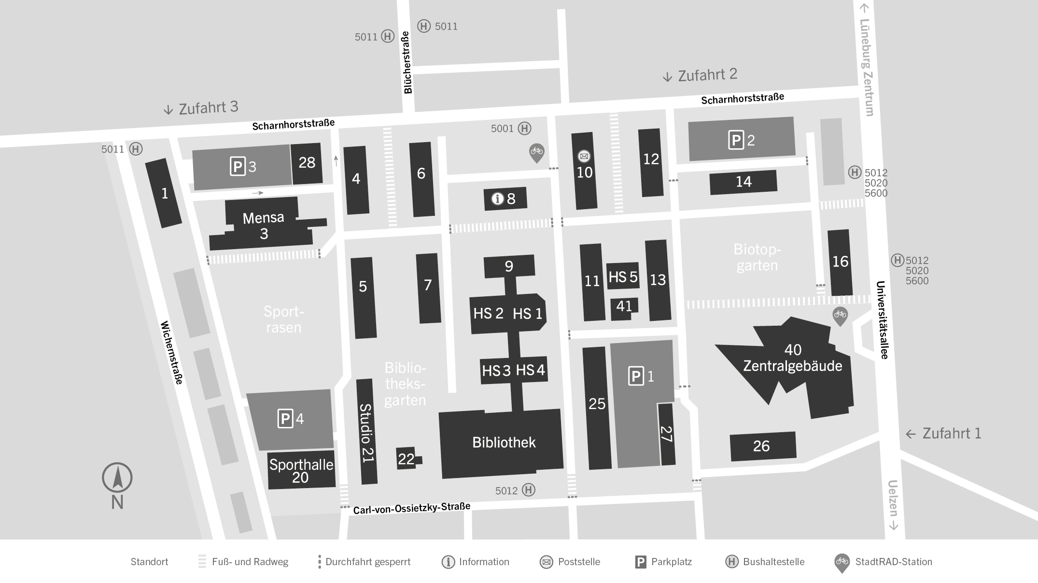
Structure of the Leuphana Tutorium
Help Desk in the trafos (Monday & Friday 10-16, Wednesday: 12-18)
Trafos: C 25
We are here
Trafos
Notes:
ari

Slide 10
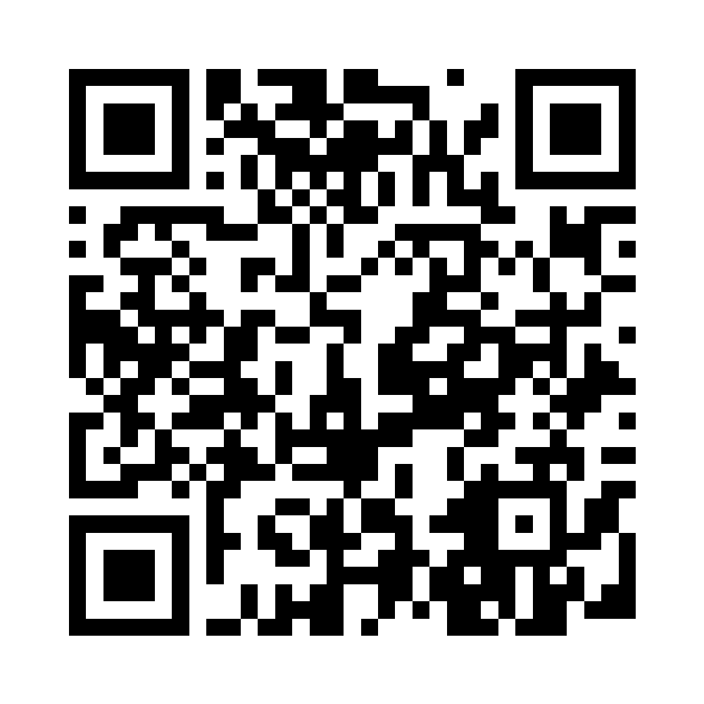
Activity Break (1)
What did you do before you started studying here?
Scan the QR or go to
https://particify.rz.tu-bs.de/p/41074492
Notes:
Katharina

Slide 11
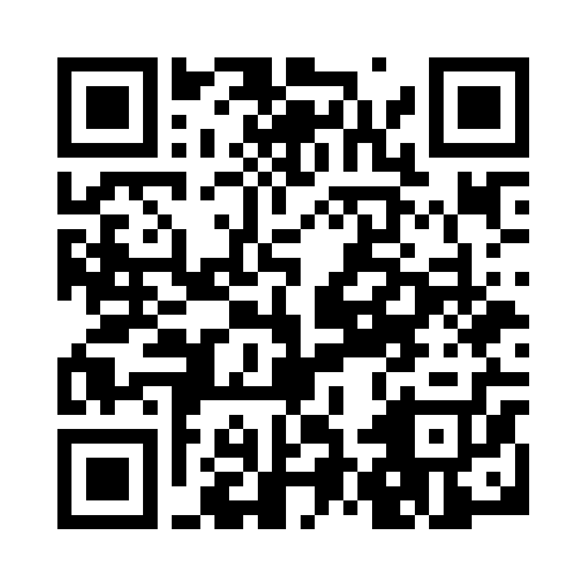
Activity Break (2
What did you do before you started studying here?
Scan the QR or go to
https://particify.rz.tu-bs.de/p/54466981
Notes:
Ari

Slide 12
University vs. School
Notes:
Prepared some of the most important aspects
Ari

Slide 13
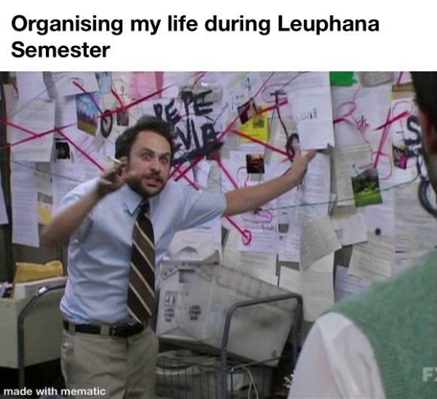
Notes:
H:
Transition
– for may of you it is the first time to study
Lots of things are new!
Life can feel comlicated – like creating the timetable, getting settles etc.

Slide 14
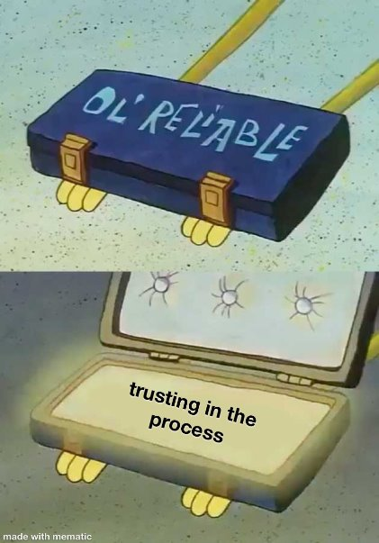
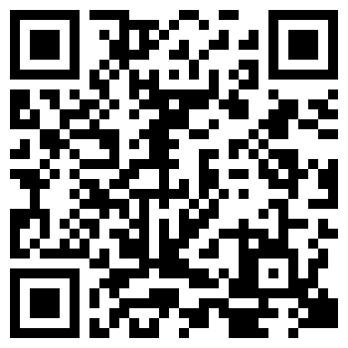
+ know your resources
Notes:
H;No worries, things will get better and easier
Hannah

Slide 15
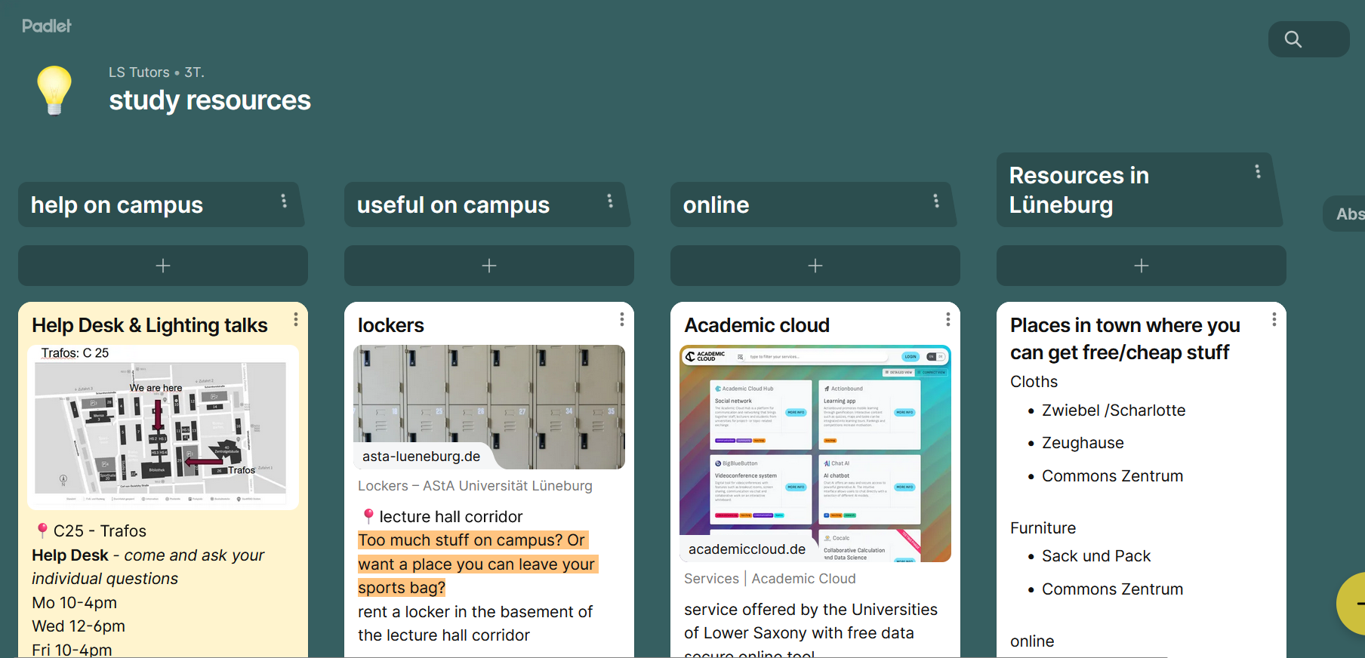
Scan here!
Notes:
H; Come to the Help Desk!

Slide 16
Office Hours of Our Help Desk
Mo. & Fr.: 10 -16
Wed. 12-18
Notes:
K:Come to the Help Desk!

Slide 17
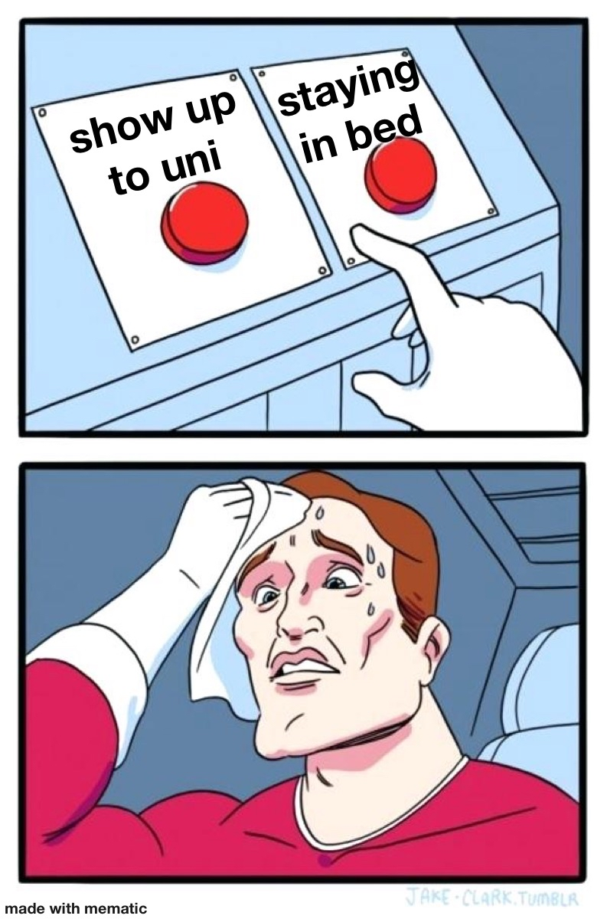
Notes:
L:Check if you modules require attendance, most of them do not
Higher own responisbility
You then can decide if you want to show up or not
Ask yourselve – why are you here? What di you want to learn and how do you learn best!

Slide 18
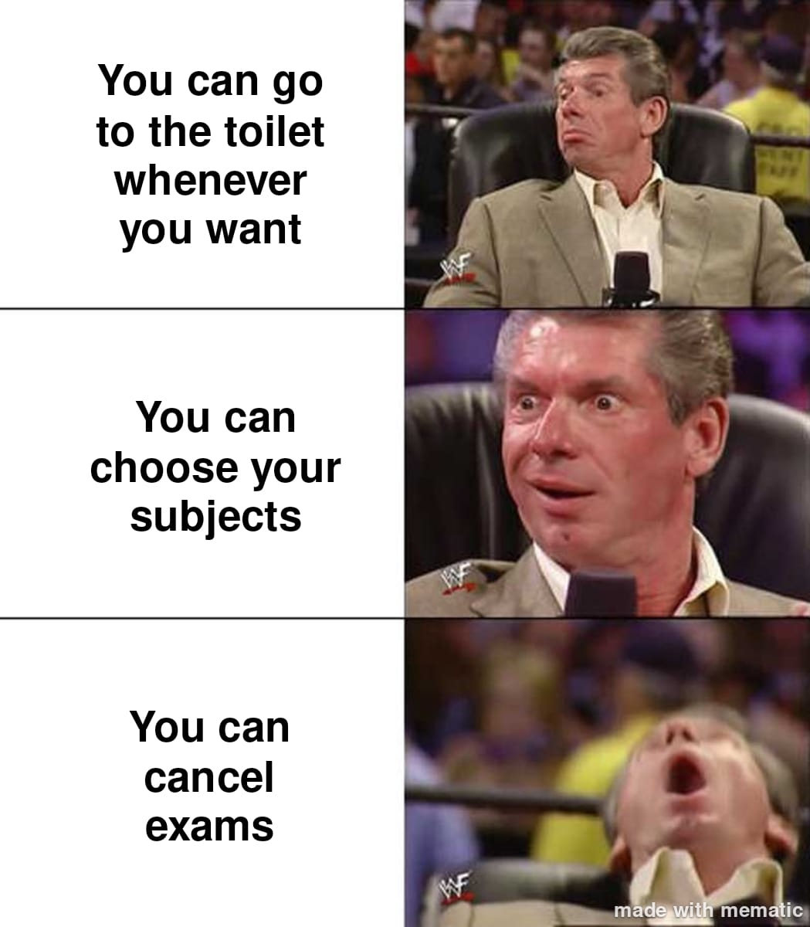
Notes:
K:You are a lot more free in deciding what you want to to and how to study
Every study jouney is different – the path is the goal
No worries if you do things differantly

Slide 19

Notes:
L: Study together in groups, discuss content of the lecture
Study „as a team“ > increases motivation and accountability
Study buddy - Hannah´s experience
Hannah until here

Slide 20
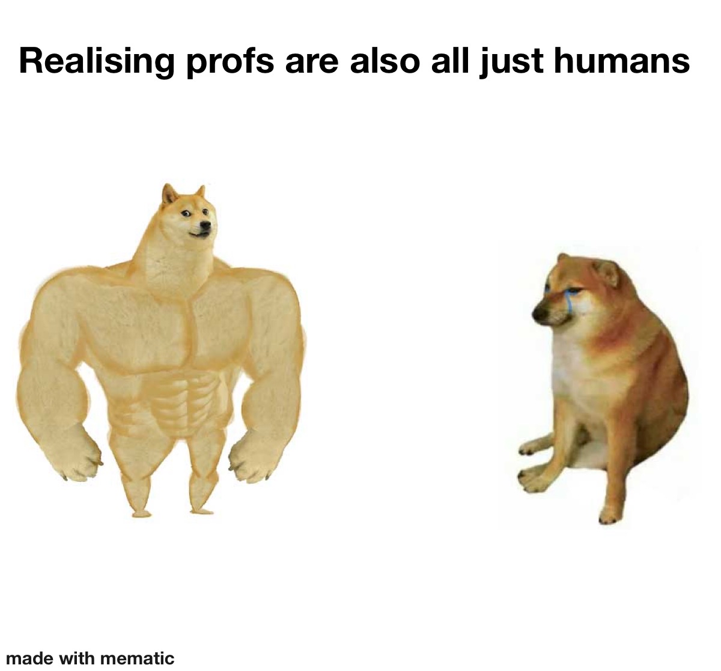
Notes:
K:Profs mainly do reaseach, they publish papers and your learning is only a small part of their job
Profs are not responsible for your learning process
Ask questions to learn and understand -> when they get los in details
If you have a question or are unure about something, probably 5-10 people have the same questions

Slide 21
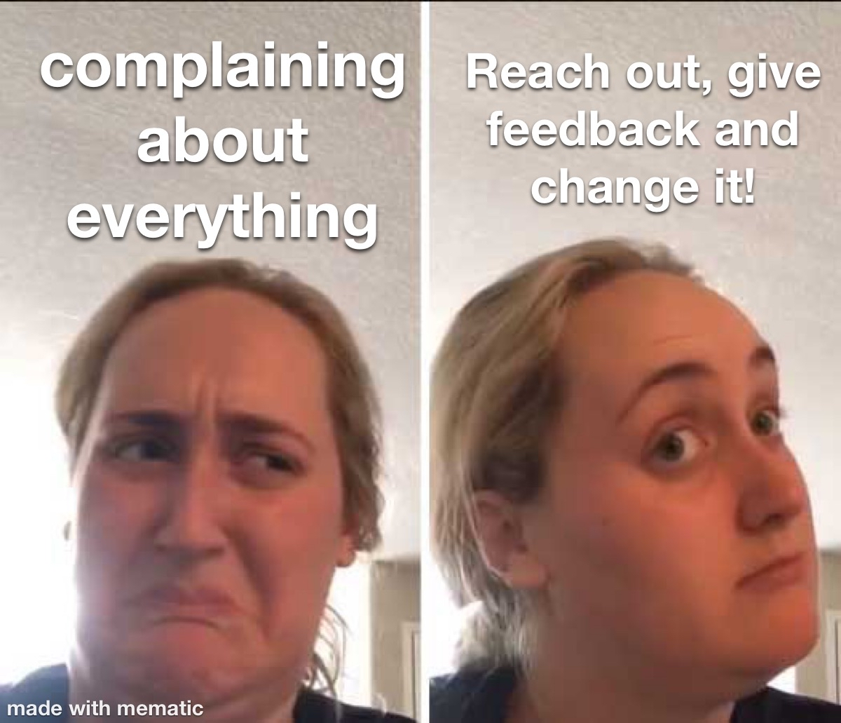
Notes:
ari
In uni you can change and influence your study experience
If you don´t like smth find out where to complain and write nice e-mails
But complaining with out doing something is wack
Go to quality circle
What is a quality circle?

Slide 22
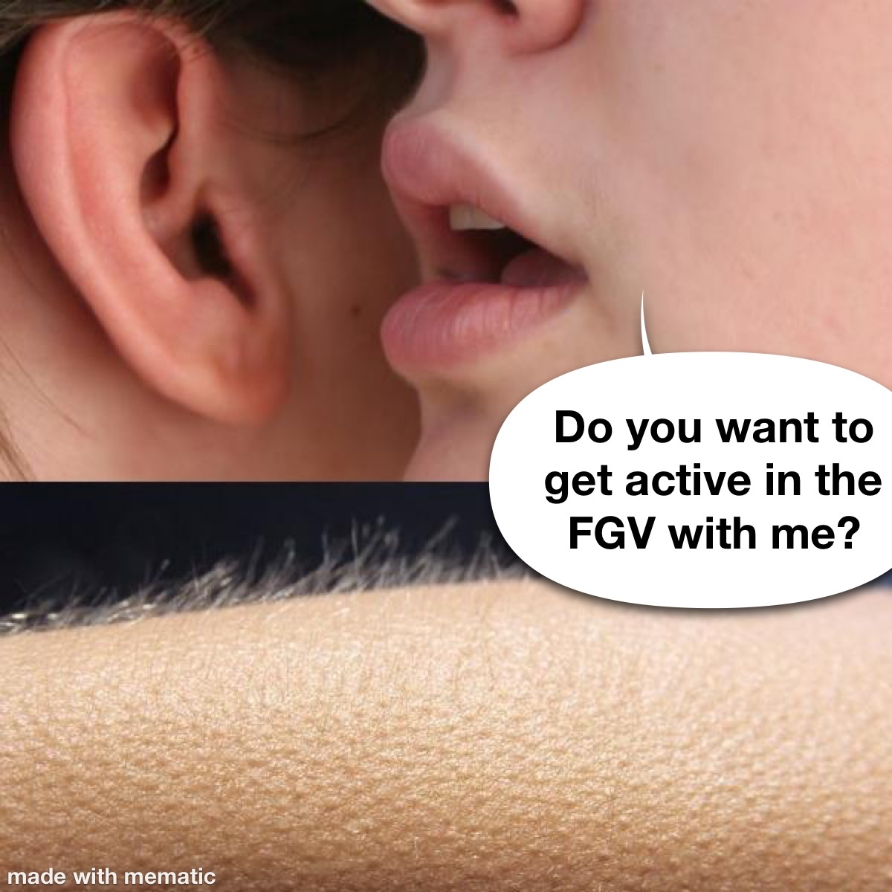
Notes:
ari:Join the FGV to find out!
FGV = Fach Gruppen Vertretung = a group of study peers in higher semesters that orgaised themselves to help others and make nice social offers
They also have study materials and old exams

Slide 23
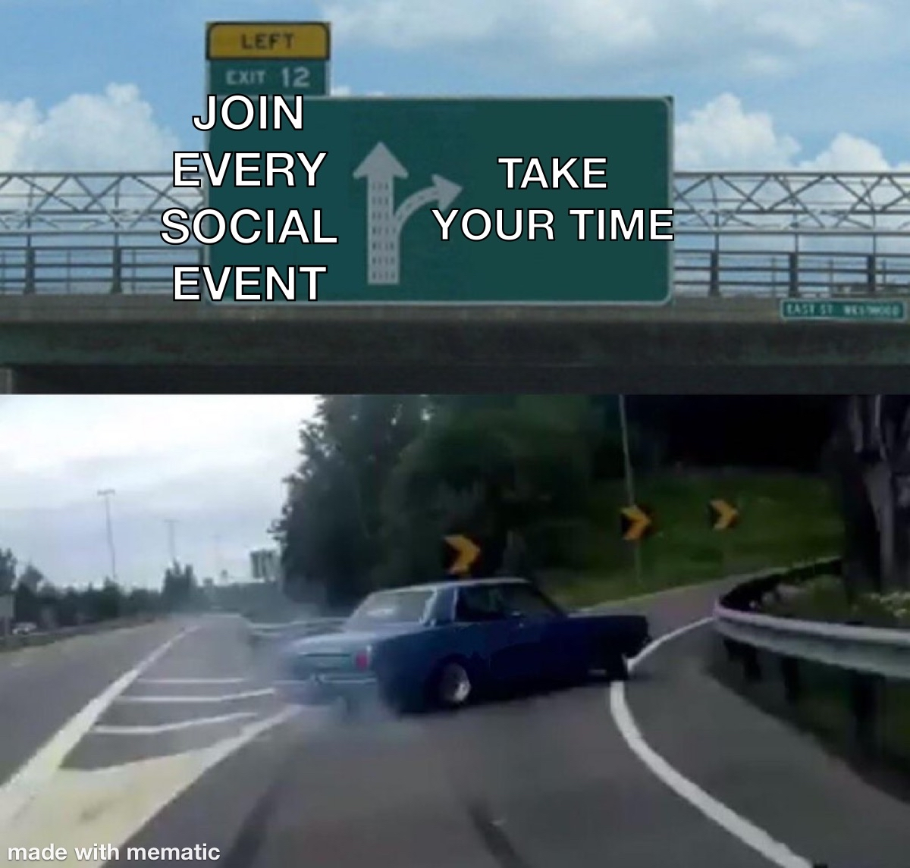
Notes:
a:Buuut in all the things that are happening - don’t overload yourselves
The Leuphana Semester will be the most stressful semester, because so many things a new (new place, new people, new systems)
But it is not there so kick or filter people out – all of oyu will make it
You can also try out something else next summer semester
Ari

Slide 24
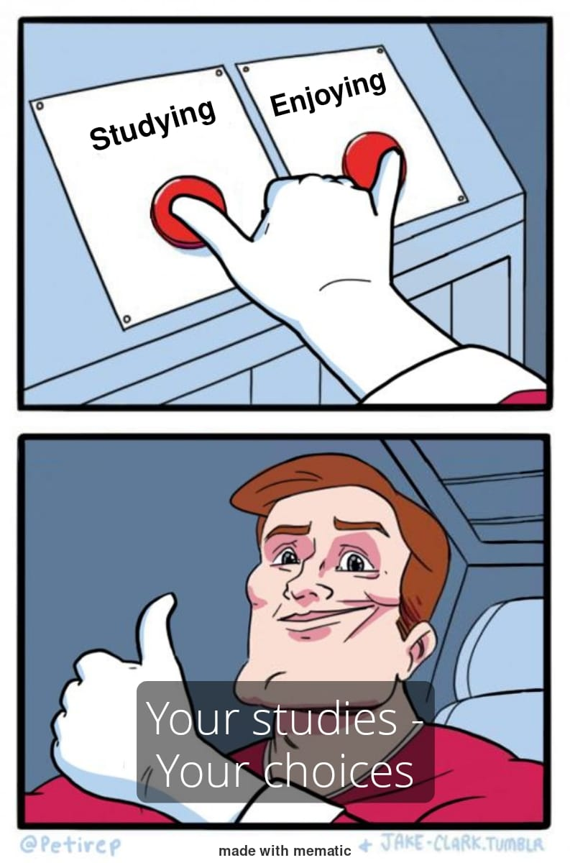
Notes:
ha

Slide 25
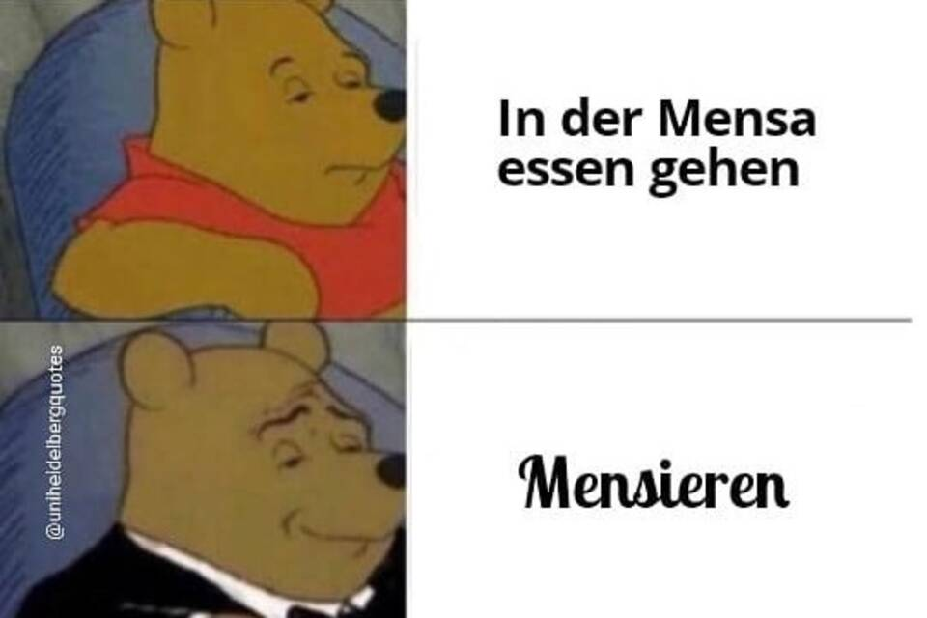

Slide 26
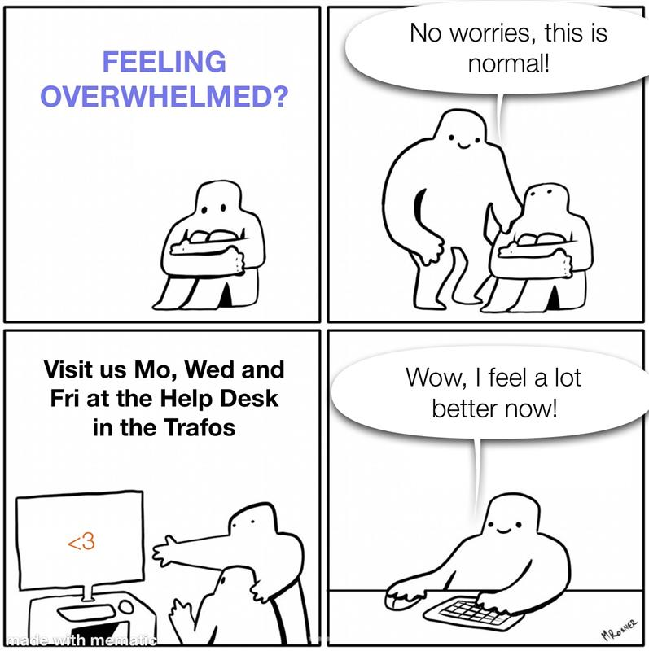
Notes:
ha

Slide 27

See you next week!
Next Lightning Talk:
Lecture Formats & How to contact Professors
22.10 14:15 HS 1
Notes:
L

